Slide 1
Quick Start Card
At the start of the game you will have a choice of 4 starting assets you can buy (green image border). The cost of these resources will be deducted from your companies capital (75,000)
Each turn the following actions will occur:
Incident – You will be given a security incident card
Mitigation – If you can mitigate the attack then do so
Business Opportunity – If you aren’t dealing with the fallout of an incident you will be able to make a new business partner from the available business cards.
Asset Management – You can buy and sell assets at the end of every turn. Only 1 asset may be brought and only 1 sold each turn.
At the end of the game tally up your capital, reputation points and number of business partners – This will be used to decide the winner

Slide 2
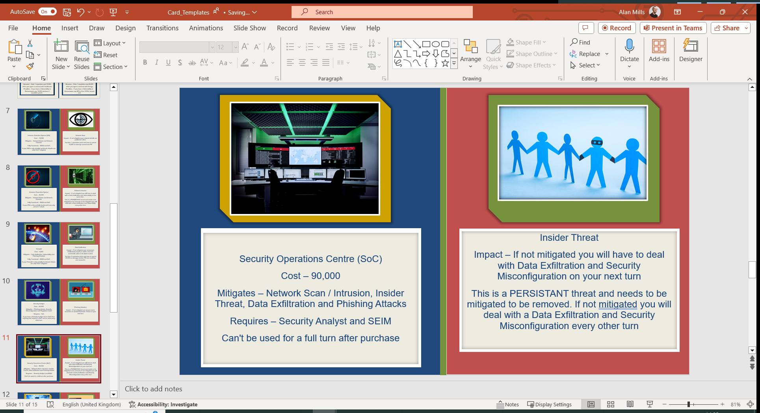
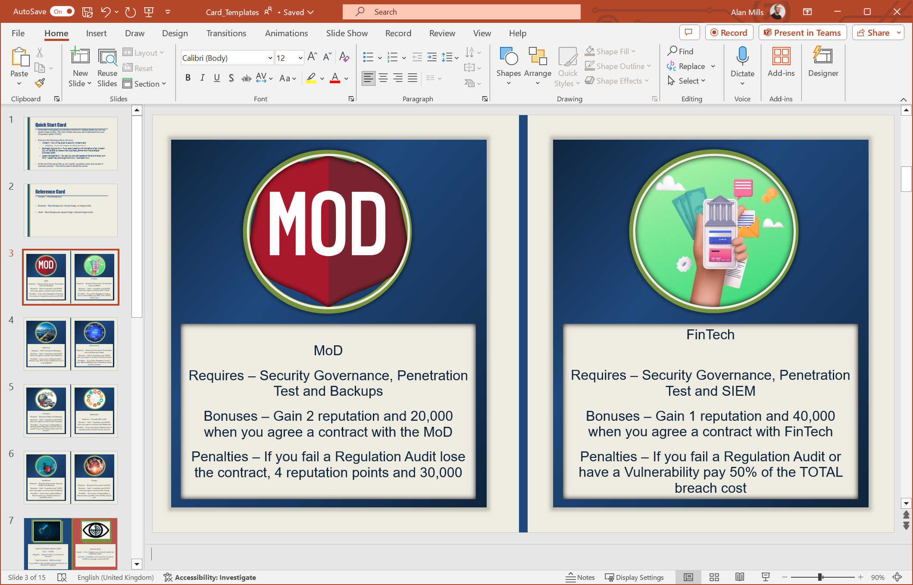
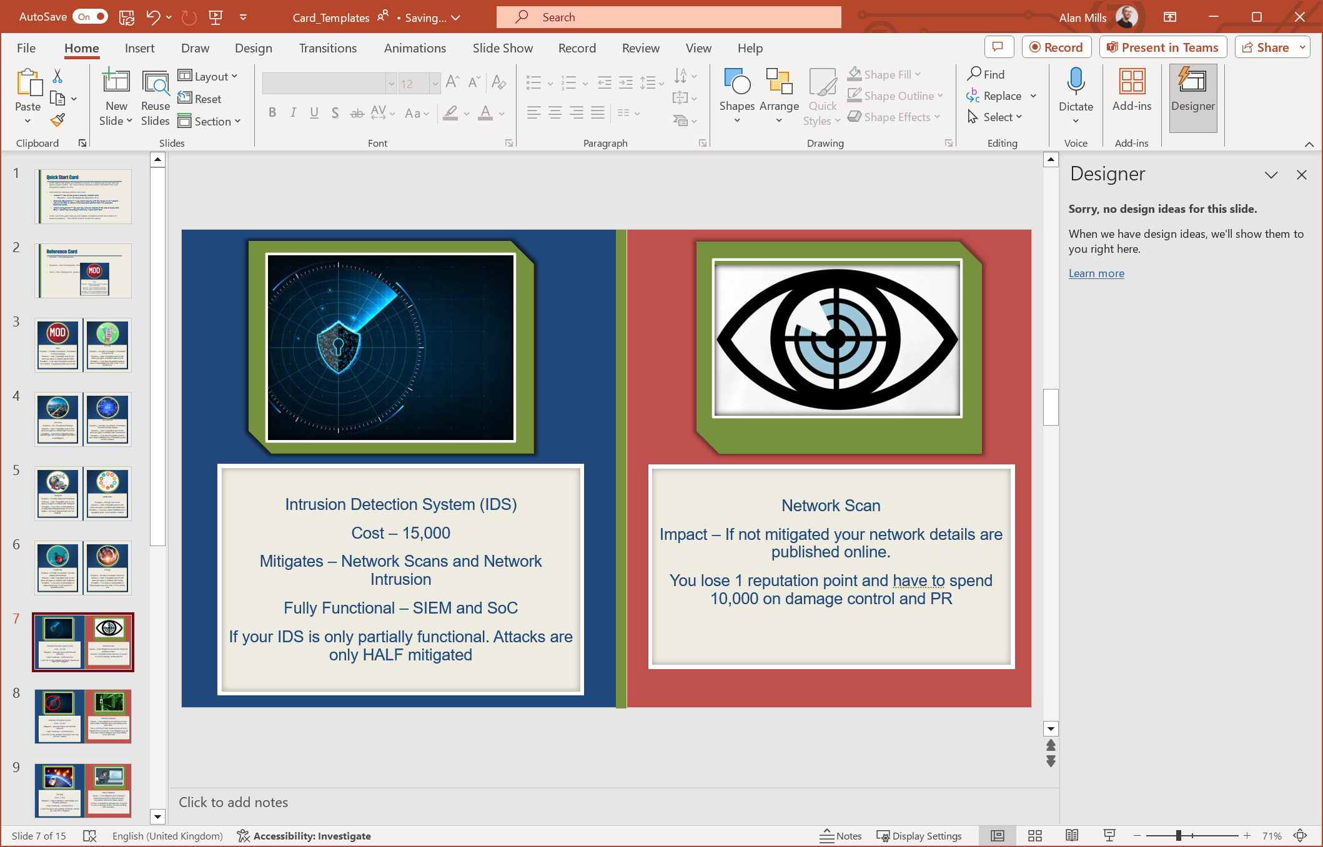
Reference Card
Incident – Red Background
Business – Blue Background
Circular image
No image border
Asset – Blue Background
Square image
Coloured image border

Slide 3

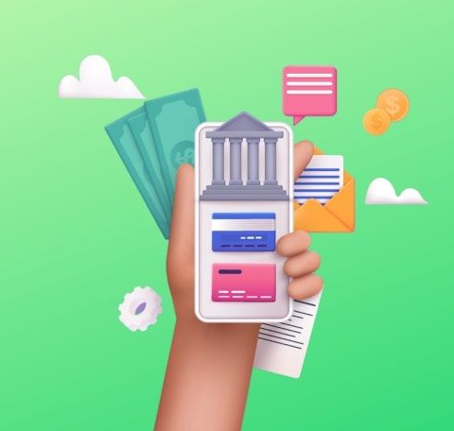
MoD
Requires – Security Governance, Penetration Test and Backups
Bonuses – Gain 2 reputation and 20,000 when you agree a contract with the MoD
Penalties – If you fail a Regulation Audit lose the contract, 4 reputation points and 30,000
FinTech
Requires – Security Governance, Penetration Test and SIEM
Bonuses – Gain 1 reputation and 40,000 when you agree a contract with FinTech
Penalties – If you fail a Regulation Audit or have a Vulnerability pay 50% of the TOTAL breach cost

Slide 4


TeleComs
Requires – IPS, Firewall and Backups
Bonuses – Gain 1 reputation and 20,000 when you agree a contract with TeleComs
Penalties – If you have a Network Scan / Intrusion pay 10% of your capital each turn it is unmitigated
Government
Requires – Security Governance, Penetration Test and Security Analyst
Bonuses – Gain 2 reputation and 15,000 when you agree a contract with Government
Penalties – If you fail a Regulation Audit or have Data Exfiltration lose 4 reputation points and the contract

Slide 5


Transport
Requires – Security Analyst and Backups
Bonuses – Gain 1 reputation and 30,000 when you agree a contract with Transport
Penalties – If you have a Vulnerability or Security Misconfiguration pay 5% of your capital. If you have Ransomware lose the contract
Multimedia
Requires – Firewall, IDS or IPS
Bonuses – Gain 1 reputation and 25,000 when you agree a contract with Multimedia
Penalties – If you have Data Exfiltration lose 1 reputation point, 30,000 and the contract

Slide 6


Healthcare
Requires – Security Governance, Security Analyst and Backups
Bonuses – Gain 1 reputation and 15,000 when you agree a contract with Healthcare
Penalties – If you have a Vulnerability or Ransomware pay 15,000 and lose 2 reputation points
Energy
Requires – Security Governance and SoC
Bonuses – Gain 1 reputation and 40,000 when you agree a contract with Energy
Penalties – If you have a Vulnerability or Ransomware pay 50% of the TOTAL breach cost

Slide 7


Intrusion Detection System (IDS)
Cost – 15,000
Mitigates – Network Scans and Network Intrusion
Fully Functional – SIEM and SoC
If your IDS is only partially functional. Attacks are only HALF mitigated
Network Scan
Impact – If not mitigated your network details are published online.
You lose 1 reputation point and have to spend 10,000 on damage control and PR

Slide 8


Intrusion Prevention System
Cost – 20,000
Mitigates – Network Scans and Network Intrusion
Fully Functional – SIEM and SoC
If your IPS is only partially functional it can only prevent 1 attack
Network Intrusion
Impact – If not mitigated you will have to deal with a Data Exfiltration and Vulnerability at the same time.
This is a PERSISTANT threat and needs to be mitigated to be removed. If not mitigated you will deal with a Data Exfiltration and Vulnerability every other turn

Slide 9
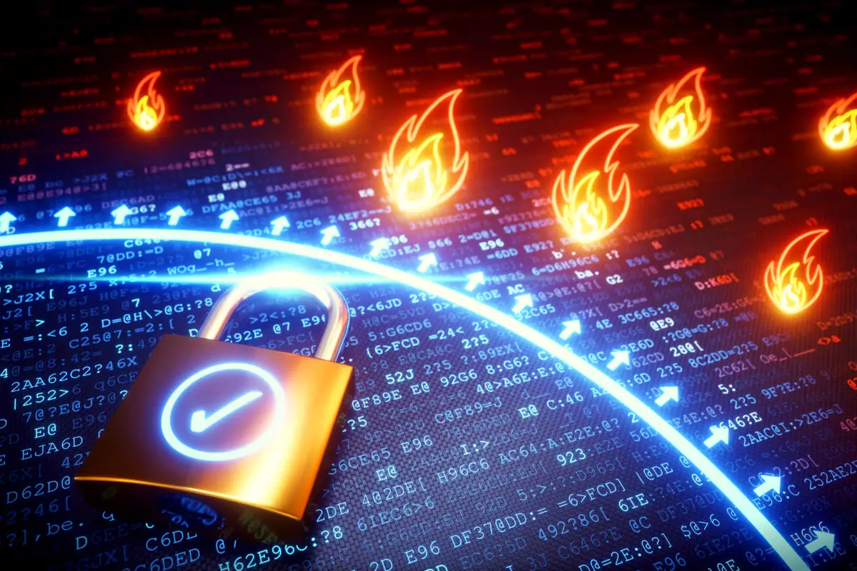
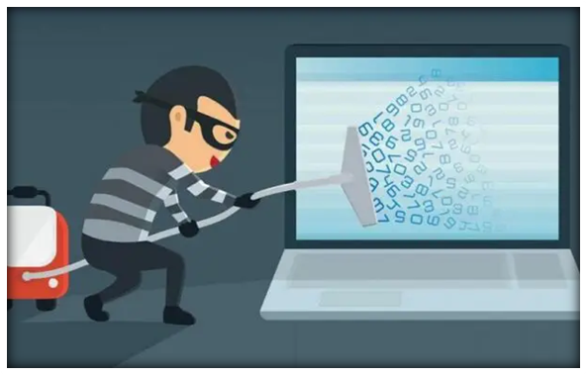
Firewall
Cost – 5,000
Mitigates – Data Exfiltration, Vulnerability and Phishing Attack(s)
Fully Functional – SIEM and SoC
If your Firewall is only partially functional. Attacks are only HALF mitigated
Data Exfiltration
Impact – If not mitigated your company's intellectual property is stolen and user credentials sold on the black market
You lose 3 reputation point and have to spend 30,000 on damage control, PR and resetting user accounts.

Slide 10

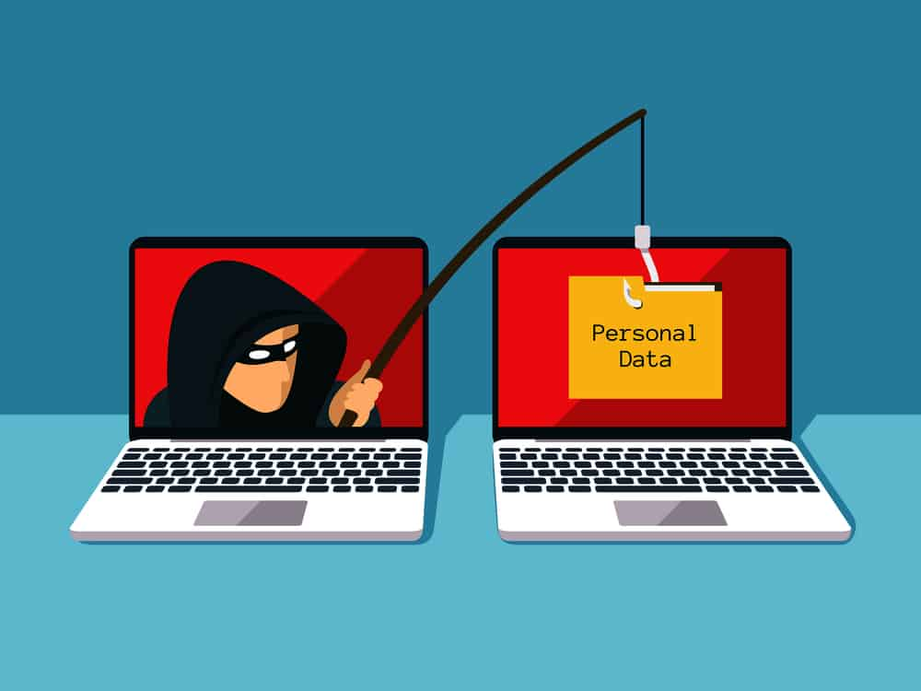
Security Analyst
Cost – 40,000
Mitigates – Phishing attacks, Security Misconfiguration and Regulation Audit
Requires – N/A
If you have a Security Analyst but no SoC then anything that requires a SoC can be used every other turn
Phishing Attack(s)
Impact – If not mitigated one of your users becomes an accidental Insider Threat on your next turn

Slide 11
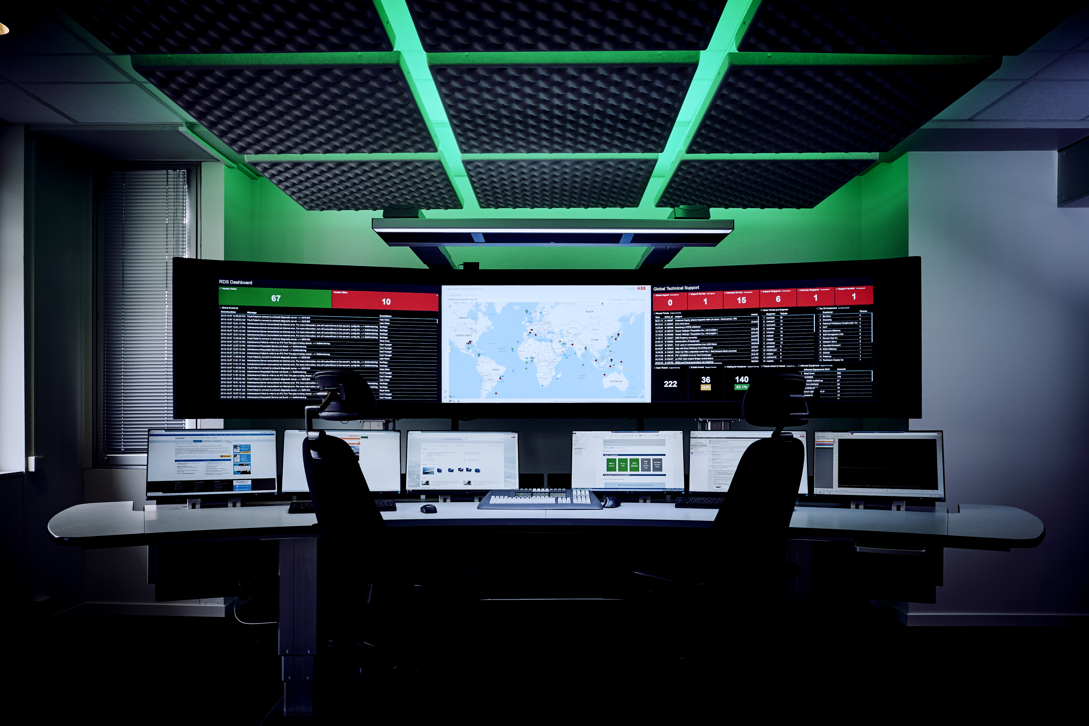

Security Operations Centre (SoC)
Cost – 90,000
Mitigates – Network Scan / Intrusion, Insider Threat, Data Exfiltration and Phishing Attacks
Requires – Security Analyst and SEIM
Can't be used for a full turn after purchase
Insider Threat
Impact – If not mitigated you will have to deal with Data Exfiltration and Security Misconfiguration on your next turn
This is a PERSISTANT threat and needs to be mitigated to be removed. If not mitigated you will deal with a Data Exfiltration and Security Misconfiguration every other turn

Slide 12

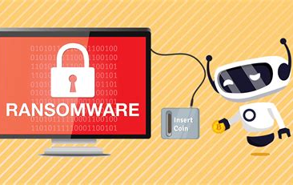
Data Backup(s)
Cost – 10,000
Mitigates – Ransomware
Requires – Security Analyst
Ransomware
Impact – All your files are belong to us! If you don't have any backups you need to pay the ransom (50,000). You lose 2 reputation points.
If you have backups you do not pay the ransom but lose a turn. You will only lose 1 reputation point.

Slide 13

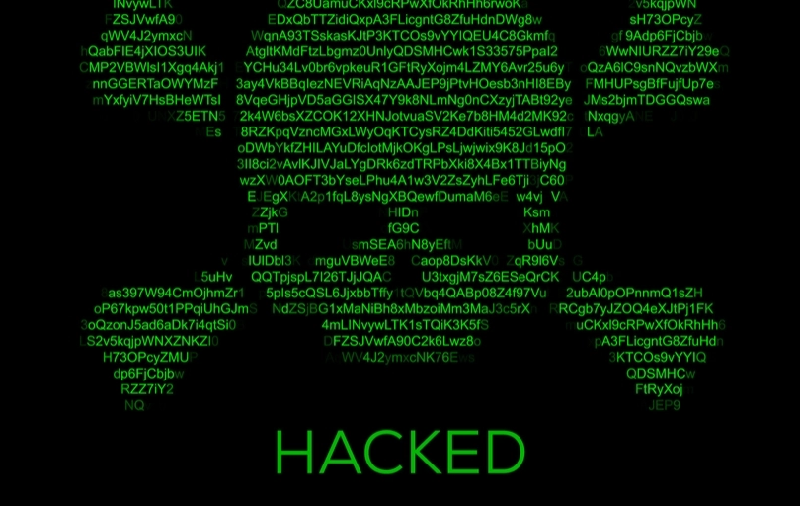
Penetration Test
Cost – 10,000
Mitigates – Vulnerability, Network Intrusion, Regulation Audit and Security Misconfiguration
Requires – If you have a SoC and Security Analyst this is free but you can't use either resource in your next turn
This resource must be discarded or paid for again after use
Vulnerability
Impact – You have been pwned! Immediately deal with: Network Scan and Network Intrusion.
If you do not mitigate the vulnerability by your next turn deal with: Data Exfiltration and Ransomware
You lose 2 reputation points and have to spend 20,000 on damage control, PR and fixes

Slide 14
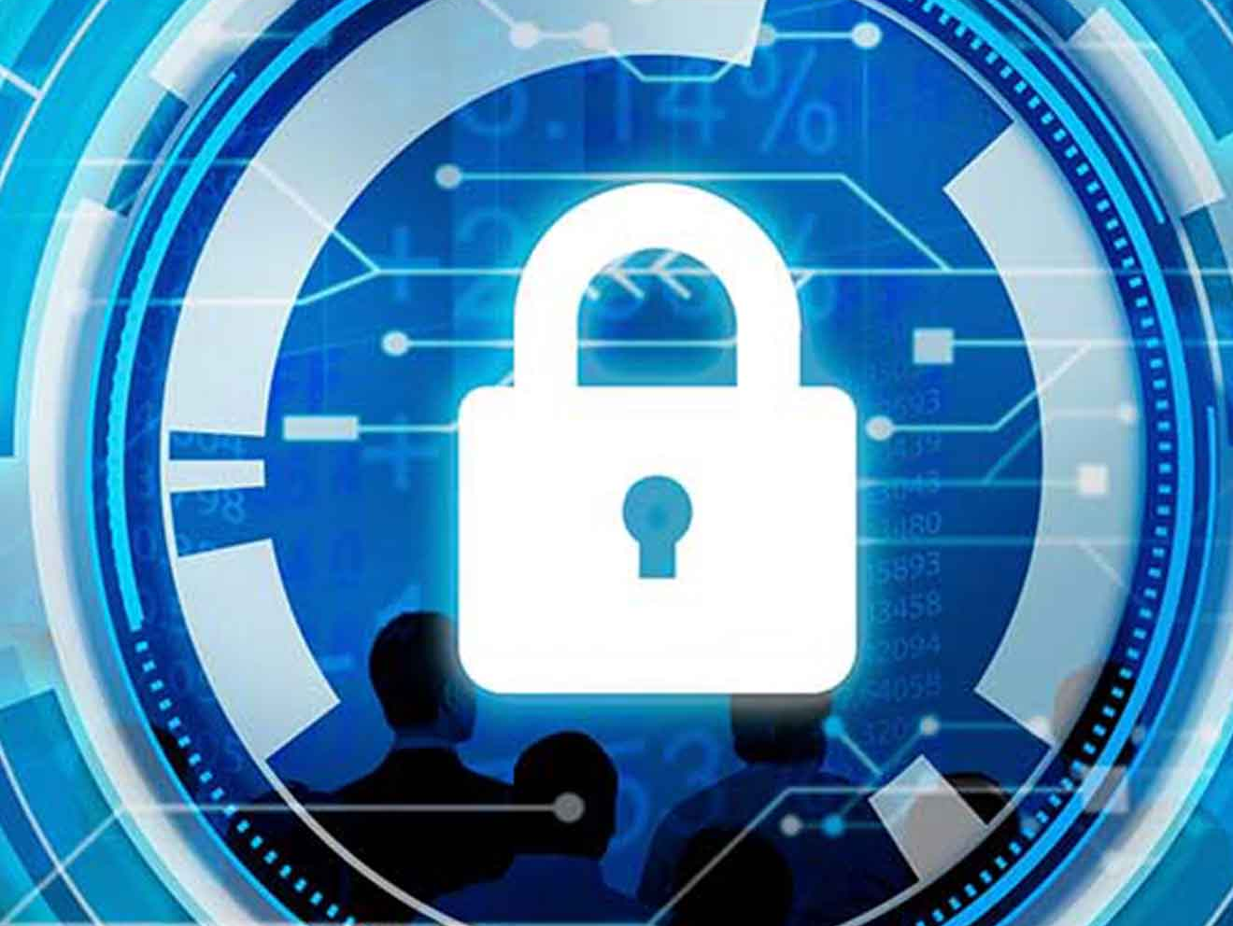

Security Governance
Cost – Security Analyst can't be used for 1 turn
Mitigates – Regulation Audit
Requires – Security Analyst
Security Misconfiguration
Impact – If not mitigated you will have a Vulnerability in your next turn

Slide 15
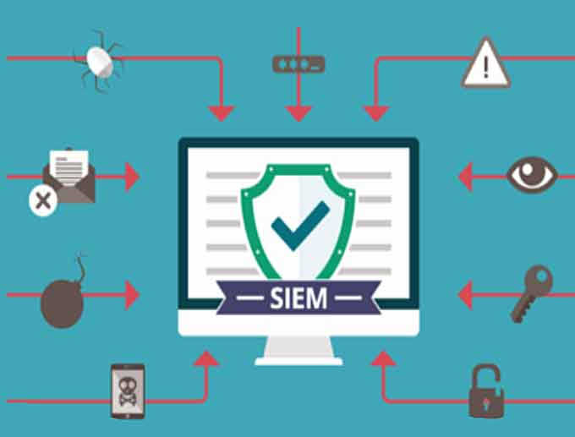

Security Information and Event Management (SIEM)
Cost – 20,000
Mitigates – Insider Threat and Phishing Attacks
Requires – Security Analyst
Regulation Audit
Impact – If not mitigated you are found to be breach of required security and compliance governance
You lose 1 reputation point and have to spend 10,000 on damage control and PR

